Slide 1
Clean Architecture

Slide 2
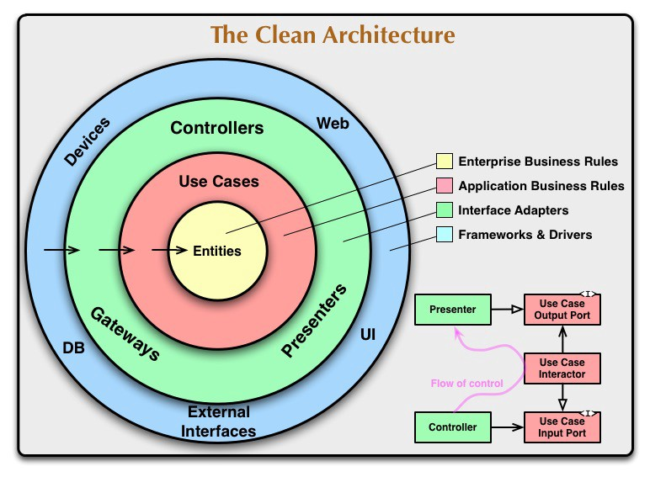
Clean Architecture
Clean Architecture is a software architectural approach that seeks to separate system responsibilities into distinct, independent layers. These layers are organized in concentric circles, with the inner layers containing the business rules and the outer layers dealing with the user interfaces and infrastructure.

Slide 3

Why we need clean Architecture:
The Spring Boot framework is the most famous framework for back-end applications in Java, it brings several facilities that have been appreciated by Web developers since the first applications using pure Servlets.The architecture in this framework basically consists of a layered architecture in which each layer communicates with another.
However, such architecture brings some problems such as domain dependency (application core) to the framework and dependency cycles between layers, which bring several points of attention that can be harmful in most cases.

Slide 4
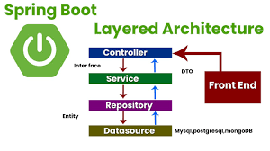
Spring boot Layered Architecture

Slide 5
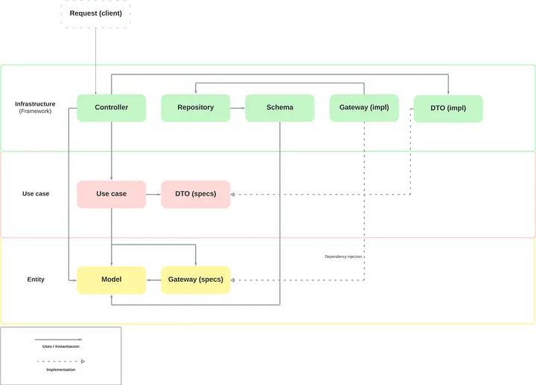
Implement Clean Architecture

Slide 6
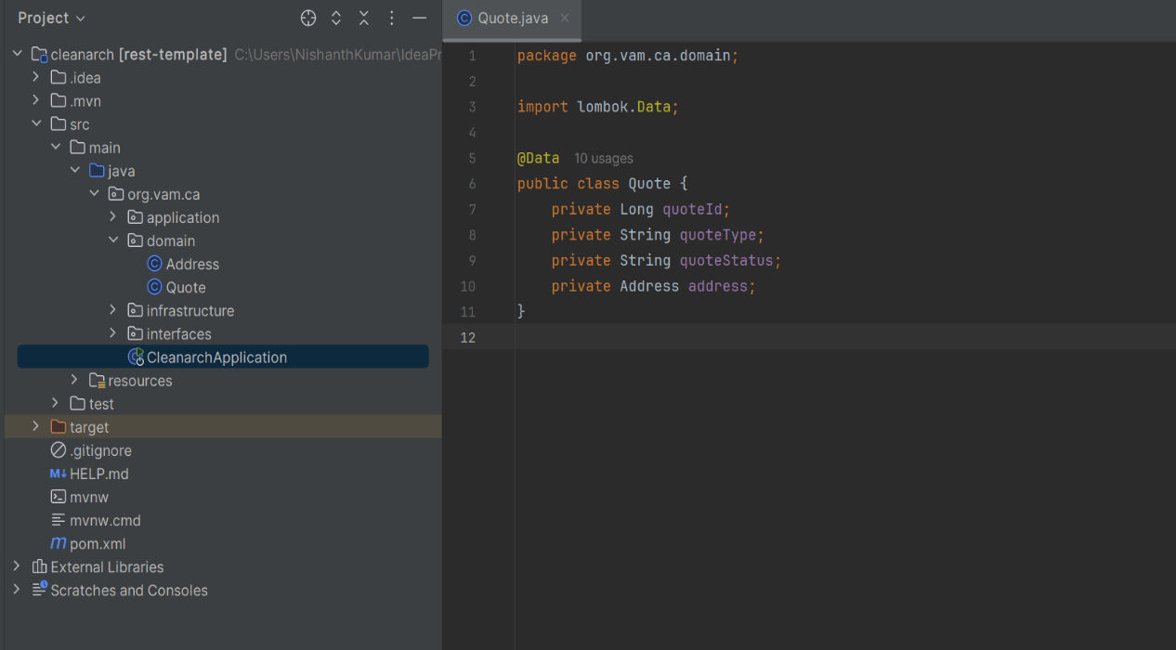
Domain/Entity
Domain/Entity
Entities are the primary building blocks of a software system, and they represent the business objects that are manipulated by the use cases. Entities encapsulate the core business rules, and they are not influenced by the user interface or any other external factor. The entities form the backbone of the application and are the most stable part of the architecture.
Eg : Quote
Address

Slide 7
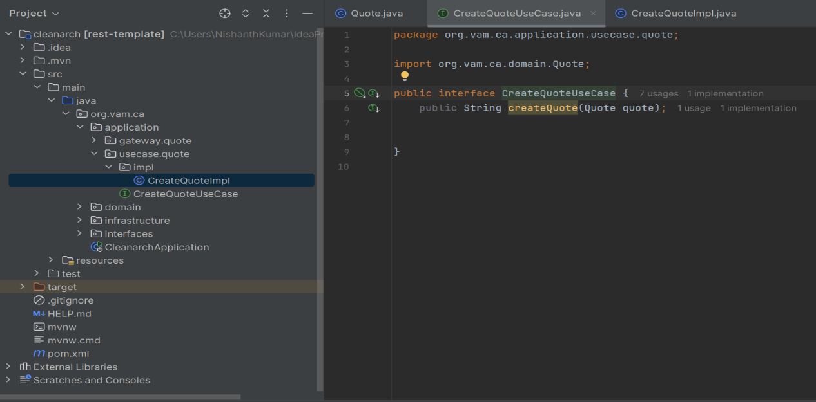
Use Case
They represent the application business rules, which are specific to the application and not to the enterprise. Use cases use entities to implement specific business rules and represent the various ways that the system can be used. Each use case represents a single action that the user can perform, and they operate on entities to produce the desired outcome.
Eg: CreateQuote
UpdateQuote
Revising Quote

Slide 8
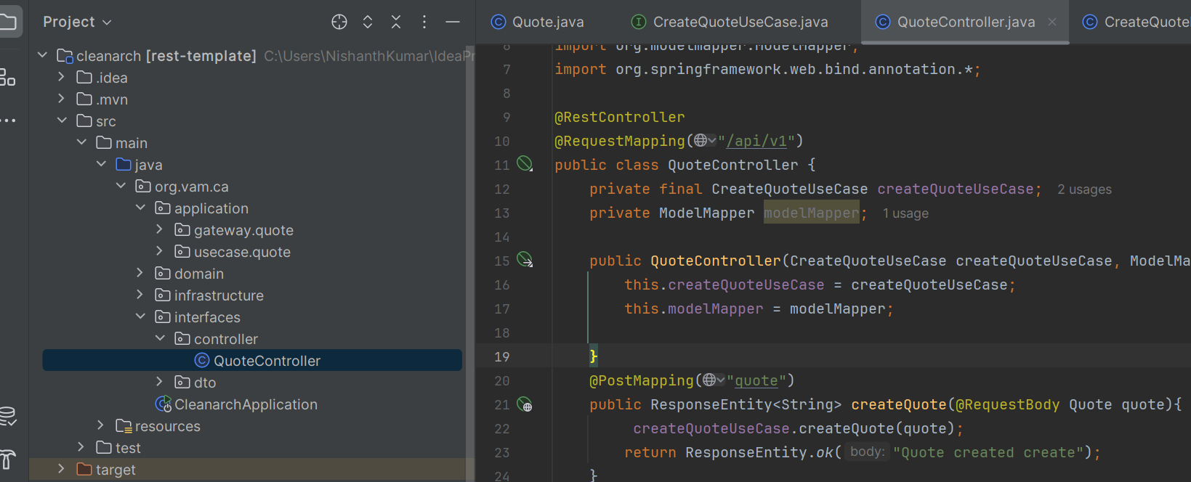
Interface Adapters
The interface adapters layer is responsible for converting data between the outside world and the use case layer.
This layer is where controllers, gateways, presenters, and other interface-related components reside.
Controllers handle user input, while gateways are responsible for accessing external data sources, such as databases or web services. Presenters are responsible for rendering data in the user interface.

Slide 9
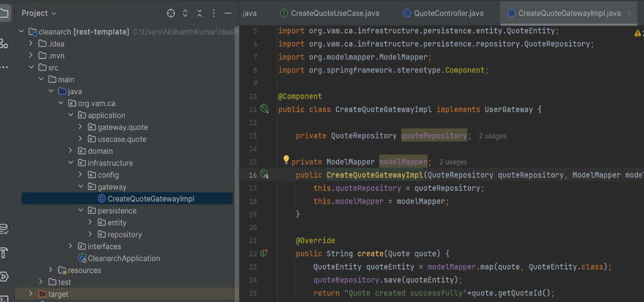
External Interface/Infrastructure
The external interfaces layer represents the interfaces that the system has with the outside world.
These interfaces can include databases, user interfaces, web APIs, and other external systems.
The external interfaces layer is responsible for translating data between the application and external systems

